Slide 1

CASINO GAME

Slide 2

CONCEPTS USED :
CLASS
HEADER FILES
FUNCTIONS

Slide 3
FUNCTIONS
Voiddrawline: it is used for decoration of the title
void drawLine(int n, char symbol)
{
for(int i=0; i<n; i++)
cout << symbol;
cout << "\n" ;
}

Slide 4
FUNCTION:
VOIDRULES: It is used to define the rules if the game .
void rules()
{
system("cls");
cout << "\n\n";
drawLine(80,'-');
cout << "\t\tRULES OF THE GAME\n";
drawLine(80,'-');
cout << "\t1. Choose any number between 1 to 10\n";
cout << "\t2. If you win you will get 10 times of money you bet\n";
cout << "\t3. If you bet on wrong number you will lose your betting amount\n\n";
drawLine(80,'-');
}

Slide 5
HEADER FILES :
In C++ program has the header file which stands for input and output stream used to take input with the help of “cin” and “cout” respectively. There are of 2 types of header file: Pre-existing header files: Files which are already available in C/C++ compiler we just need to import them.
#include <iostream>
#include <string>
#include <cstdlib>
#include <ctime>

Slide 6
SRAND AND RAND:
The srand() function sets the starting point for producing a series of pseudo-random integers. If srand() is not called, the rand() seed is set as if srand(1) were called at program start. Any other value for seed sets the generator to a different starting point.
rand() function is an inbuilt function in C++ STL, which is defined in <cstdlib> header file. rand() is used to generate a series of random numbers. We use this function when we want to generate a random number in our code.

Slide 7
Loops :
Do while loop: The do/while loop is a variant of the while loop. This loop will execute the code block once, before checking if the condition is true, then it will repeat the loop as long as the condition is true.
IF/ELSE: In computer programming, we use the if...else statement to run one block of code under certain conditions and another block of code under different conditions.

Slide 8
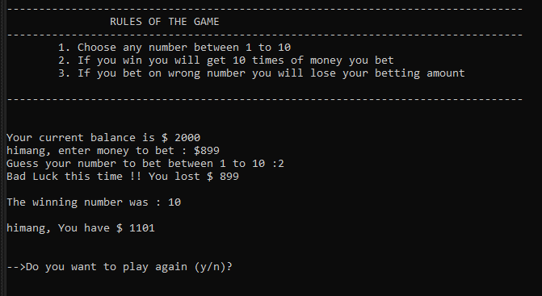
OUTPUT:

